Slide 1
Animatronic Hand
Using Mechatronic Technology

Slide 2

Presented by:
Siddhant Pratap Singh (1743120043)
Akanksha Tiwari (1743120003)
Jai Hind (1743120017)
Utkarsh Pandey (1743120049)
KM Adab Istiaq (1743120019)
Rajan Joshi (1743120033)
Presented to:
Project Guide
Dr. Abhishek Mishra
Additional Director, HOD of EE & EC
Project In-charge
Mr. Sushil Kumar
Department of Electrical Engineering

Slide 3
Progress Presentation
Arduino
Servo motor
Flex sensor
Writing of code to give basic instruction to hand
Code burn and upload virtually
Construction of Model
Working of model
Member contribution

Slide 4
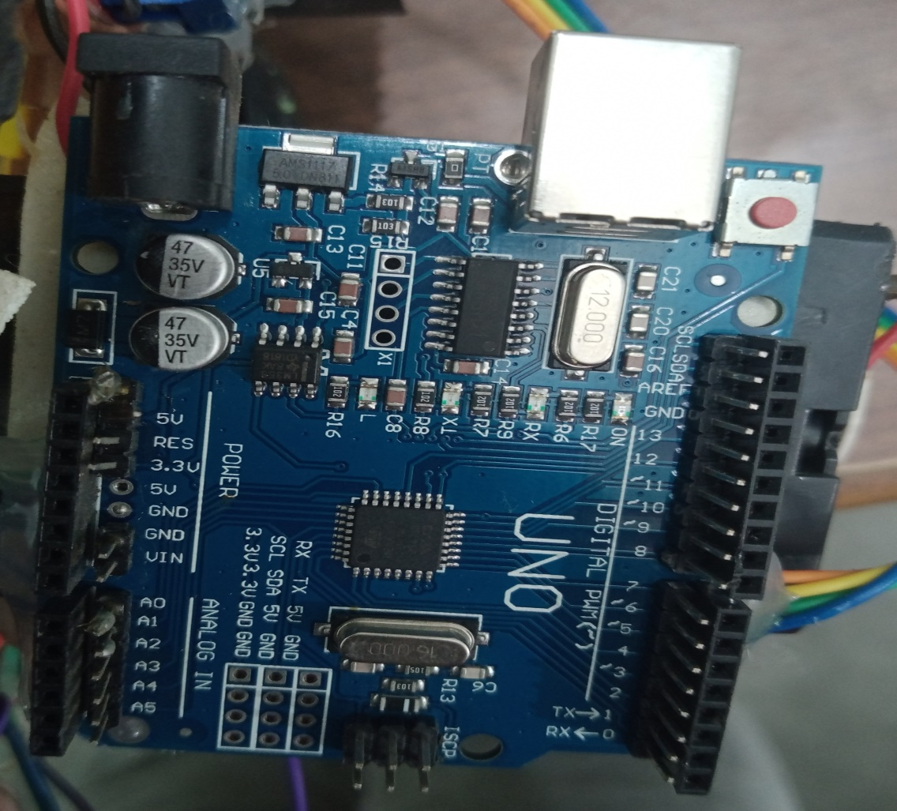
Why choose Arduino Uno for Animatronic Hand ?
DC Current for 3.3 V Pin : 50mA
Operating voltage : 5 V
Input Voltage : 7 – 12 V
Input Voltage : 6 – 20 V
Digital I/O Pins : 14
Analog Input Pins : 6
Flash Memory : 32 KB
Clock Speed : 16 MHz
DC Current per I/O : 40 mA

Slide 5
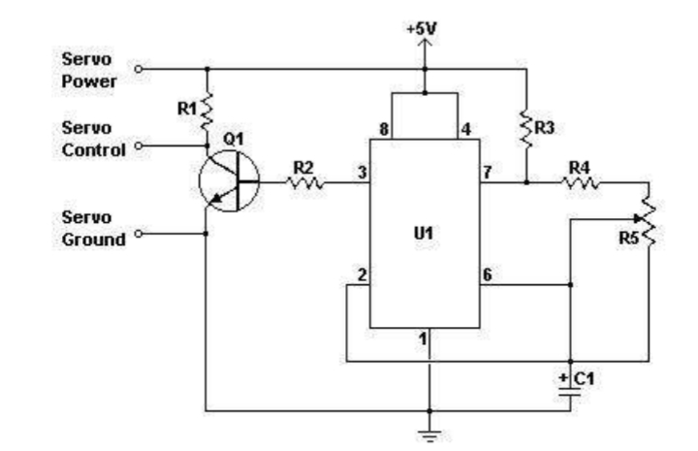
Why use Servo Motor instead of other motors ?
High Speed
High torque
Available in AC and DC Both
Small Size
Large angular force compare to their size
Operate in Closed Loop
Very accurate

Slide 6
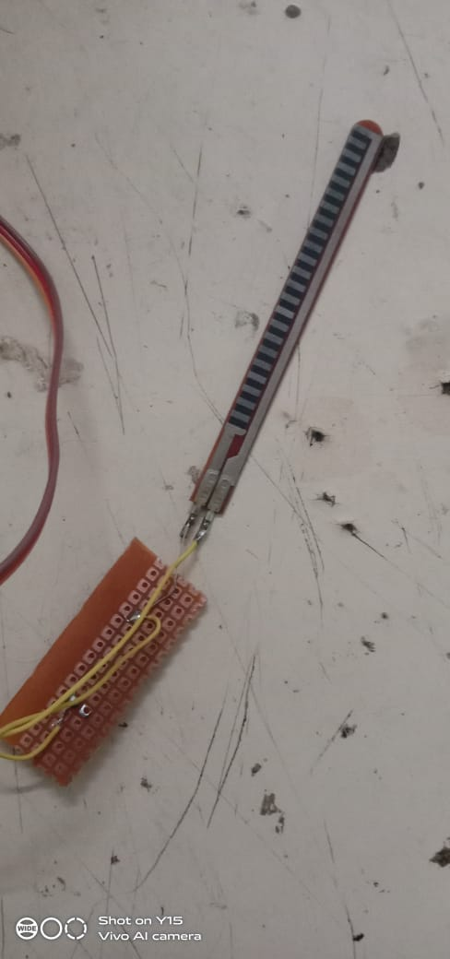
Flex Sensor
A simple flex sensor is 4.5’’ in length. As the sensor bent, the resistance across the sensor increases.
Flex sensors are sensors that change in resistance depending on the amount of bend on the sensor.
It is a passive resistance device that can be used to detect bending or flexing.

Slide 7
Writing of code to give basic instruction to hand
#include<servo.h> // include library file for servo motor
Servo myservo ; //variables defined for servo motor
Servo myservo 1;
Servo myservo 2;
Servo myservo 3;
Servo myservo 4;
// setup of serial for sensors. Setup to attach digital pins to each servo motor.
Void setup(){
Serial.begin(600);
myservo1.attach(7);
Myservo2.attach(4);

Slide 8
Myservo2.attach(3); } void loop(){ int flexsensorReading =analogRead(A4); //variables defined to take reading from sensors. int flexsensorReading1 =analogRead(A3); int flexsensorReading =analogRead(A2); int flexsensorReading =analogRead(A1); int flexsensorReading =analogRead(A0); // Final step is to send readings to digital pins for servo motors to move. Myservo.write(val); myservo.write(val1); myservo.write(val2); myservo.write(val3); myservo.write(val4); }

Slide 9
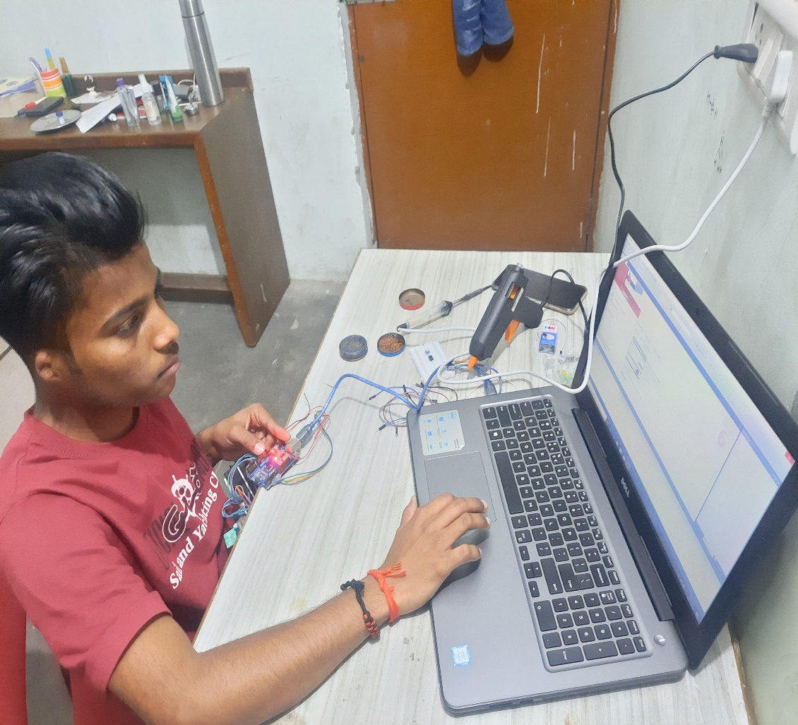
Code burn and upload virtually
Connected our Arduino to the computer with the USB cable. We did not need the battery for that time. The green PWR LED will light. If there was already a program burned into the Arduino, it will run.
Started the Arduino development environment. In Arduino-speak, programs are called “sketches”, but here we will just call them programs. Our window would look something like this.
Then we clicked the Upload button or Ctrl-U to compile the program and load on the Arduino Bboard.

Slide 10
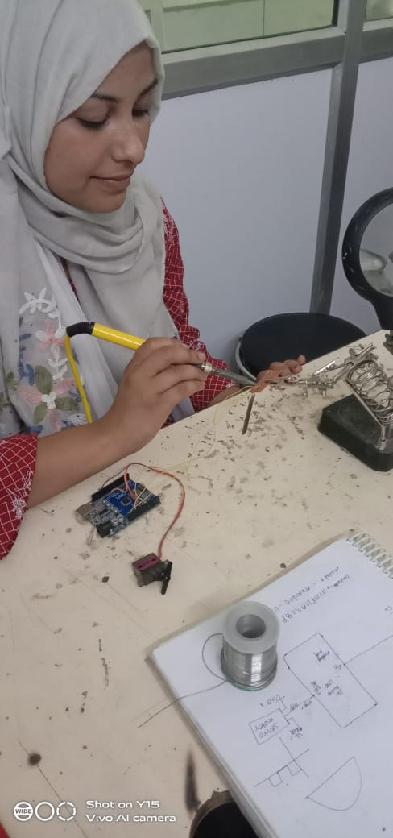
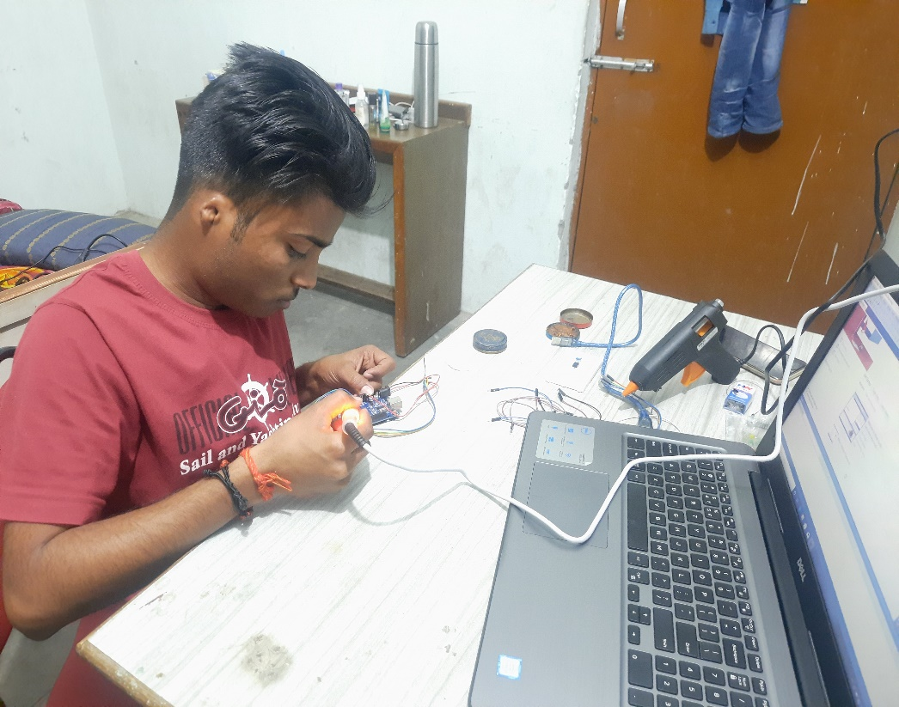
Construction of Model
Connecting sensor with Arduino
Making connections to upload code

Slide 11
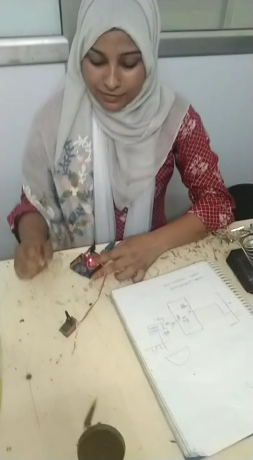
Working of model

Slide 12
Member Contribution

